Slide 1
Introduction to Differential Equations - Lecture 4
Fei Qi
Email: fei.qi@du.edu
Office Hour: TBA
Website: https://feiqimath.github.io

Slide 2
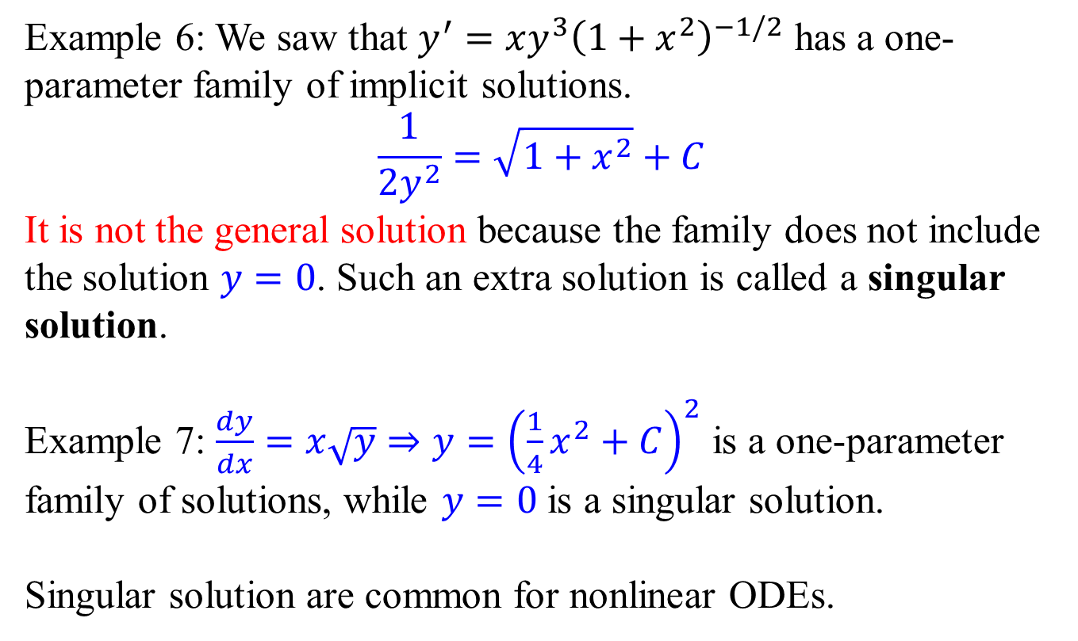
Singular solution
Example 6: We saw that $y^{′}=xy^{3}{\left(1+x^{2}\right)}^{−1/2}$ has a one-parameter family of implicit solutions.
$$\frac{1}{2y^{2}}=\sqrt{1+x^{2}}+C$$
It is not the general solution because the family does not include the solution $y=0$. Such an extra solution is called a singular solution.
Example 7: $\frac{dy}{dx}=x\sqrt{y}⇒y={\left(\frac{1}{4}x^{2}+C\right)}^{2}$ is a one-parameter family of solutions, while $y=0$ is a singular solution.
Singular solution are common for nonlinear ODEs.

Slide 3
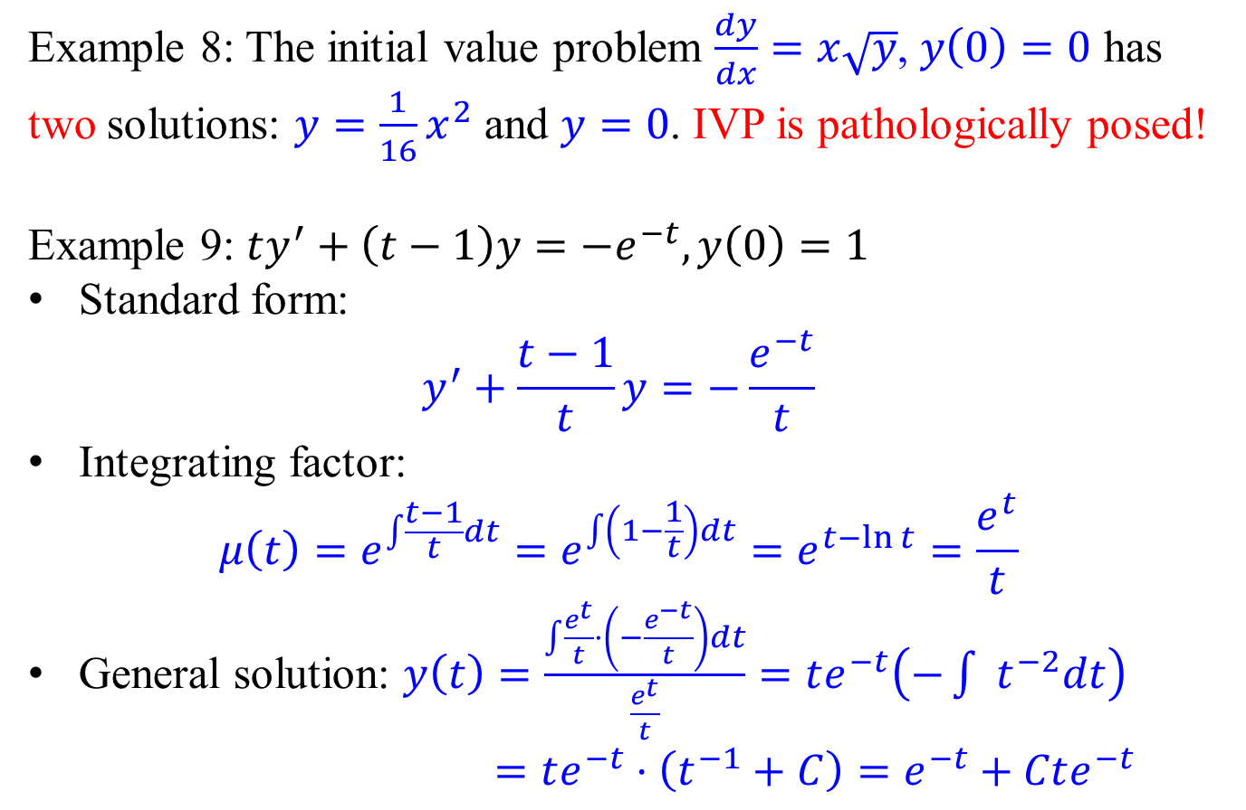
Pathological IVP
Example 8: The initial value problem $\frac{dy}{dx}=x\sqrt{y}$, $y\left(0\right)=0$ has two solutions: $y=\frac{1}{16}x^{2}$ and $y=0$. IVP is pathologically posed!
Example 9: $ty^{′}+\left(t−1\right)y=−e^{−t},y\left(0\right)=1$
Standard form:
$$y^{′}+\frac{t−1}{t}y=−\frac{e^{−t}}{t}$$
Integrating factor: $μ\left(t\right)=e^{\int{\frac{t−1}{t}dt}}=e^{\int{\left(1−\frac{1}{t}\right)dt}}=e^{t−\ln{t}}=\frac{e^{t}}{t}$
General solution: $y\left(t\right)=\frac{\int{\frac{e^{t}}{t}⋅\left(−\frac{e^{−t}}{t}\right)dt}}{\frac{e^{t}}{t}}=te^{−t}\left(−\int{ t^{−2}dt}\right)$ $=te^{−t}⋅\left(t^{−1}+C\right)=e^{−t}+Cte^{−t}$

Slide 4
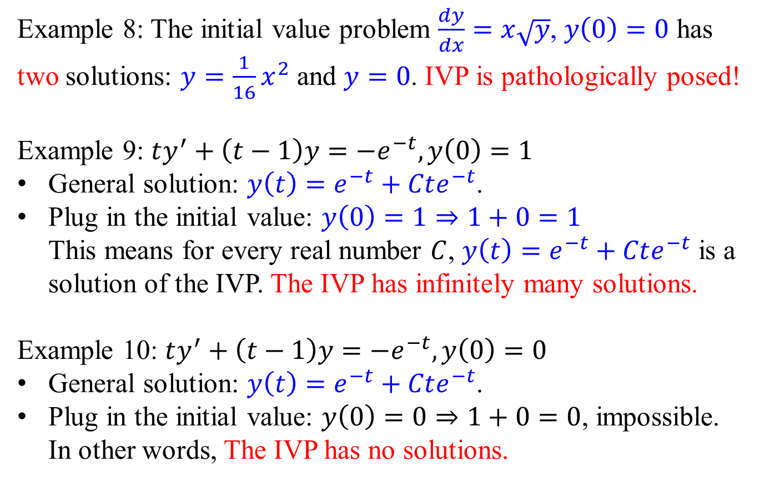
Pathological IVP
Example 8: The initial value problem $\frac{dy}{dx}=x\sqrt{y}$, $y\left(0\right)=0$ has two solutions: $y=\frac{1}{16}x^{2}$ and $y=0$. IVP is pathologically posed!
Example 9: $ty^{′}+\left(t−1\right)y=−e^{−t},y\left(0\right)=1$
General solution: $y\left(t\right)=e^{−t}+Cte^{−t}$.
Plug in the initial value: $y\left(0\right)=1⇒1+0=1$ This means for every real number $C$, $y\left(t\right)=e^{−t}+Cte^{−t}$ is a solution of the IVP. The IVP has infinitely many solutions.
Example 10: $ty^{′}+\left(t−1\right)y=−e^{−t},y\left(0\right)=0$
General solution: $y\left(t\right)=e^{−t}+Cte^{−t}$.
Plug in the initial value: $y\left(0\right)=0⇒1+0=0$, impossible. In other words, The IVP has no solutions.

Slide 5
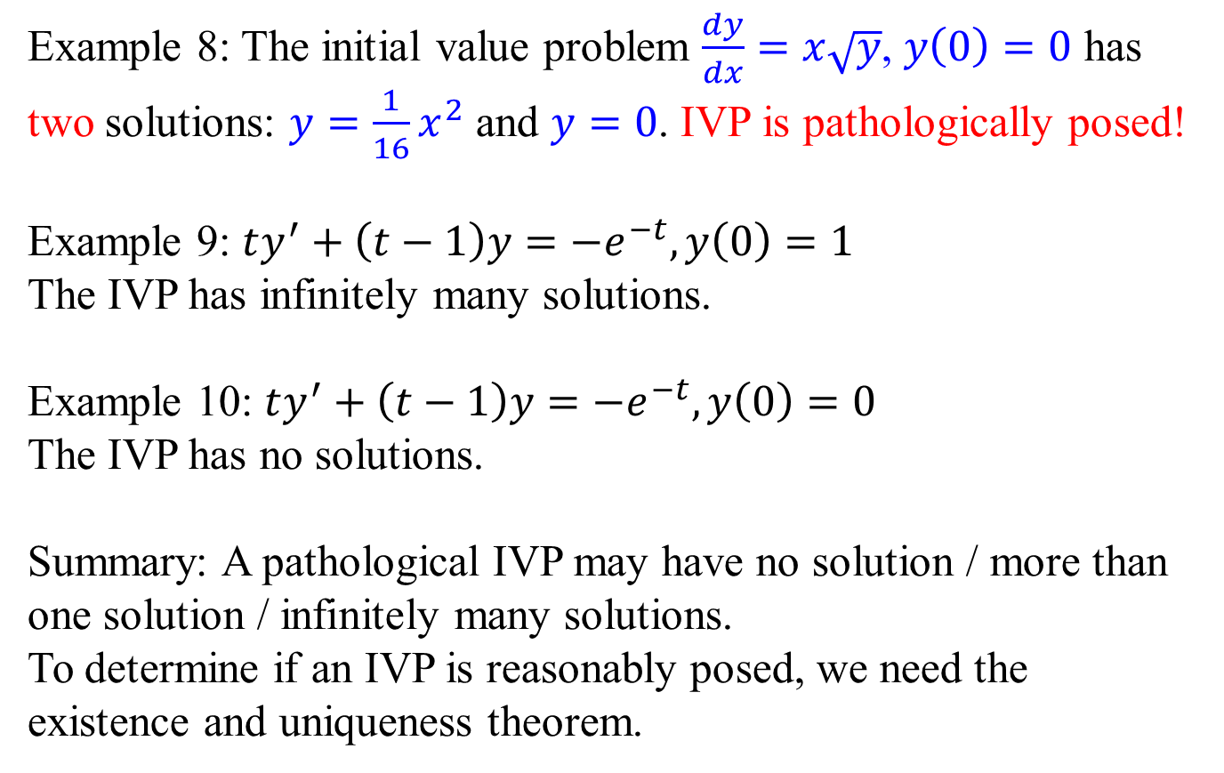
Pathological IVP
Example 8: The initial value problem $\frac{dy}{dx}=x\sqrt{y}$, $y\left(0\right)=0$ has two solutions: $y=\frac{1}{16}x^{2}$ and $y=0$. IVP is pathologically posed!
Example 9: $ty^{′}+\left(t−1\right)y=−e^{−t},y\left(0\right)=1$
The IVP has infinitely many solutions.
Example 10: $ty^{′}+\left(t−1\right)y=−e^{−t},y\left(0\right)=0$
The IVP has no solutions.
Summary: A pathological IVP may have no solution / more than one solution / infinitely many solutions.
To determine if an IVP is reasonably posed, we need the existence and uniqueness theorem.

Slide 6
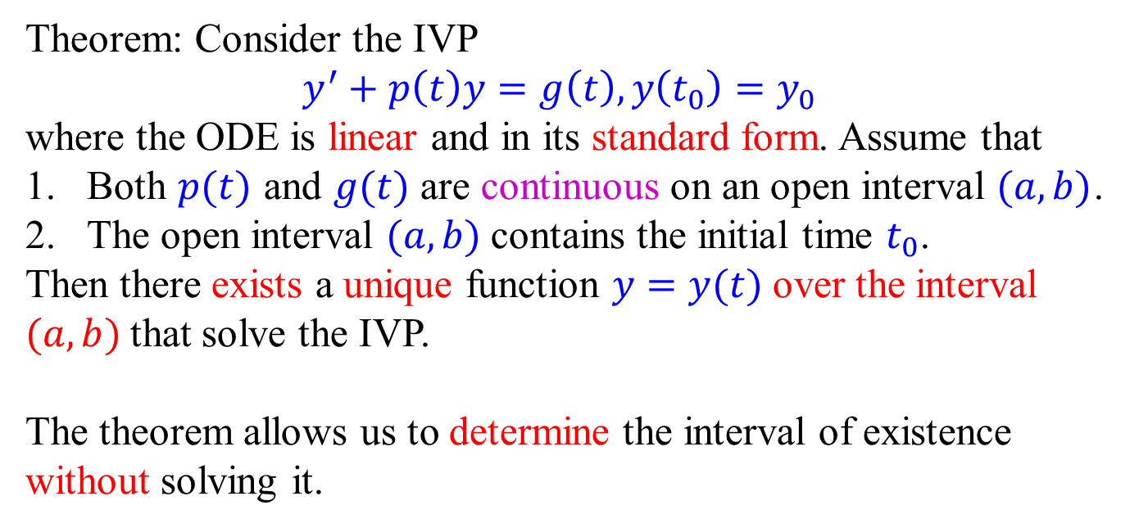
Existence and uniqueness theorem: linear version
Theorem: Consider the IVP
$$y^{′}+p\left(t\right)y=g\left(t\right), y\left(t_{0}\right)=y_{0}$$
where the ODE is linear and in its standard form. Assume that
Both $p(t)$ and $g(t)$ are continuous on an open interval $(a, b)$.
The open interval $(a, b)$ contains the initial time $t_{0}$.
Then there exists a unique function $y=y(t)$ over the interval $(a, b)$ that solve the IVP.
The theorem allows us to determine the interval of existence without solving it.

Slide 7
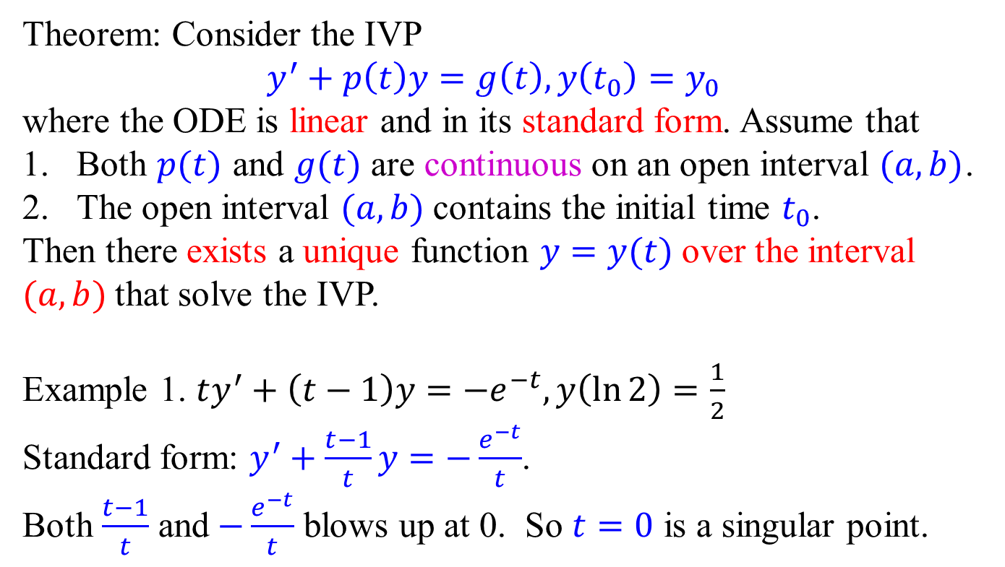
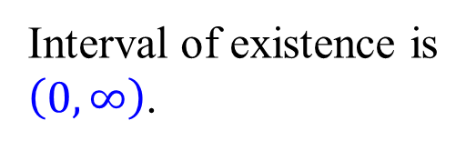

Existence and uniqueness theorem: linear version
Theorem: Consider the IVP
$$y^{′}+p\left(t\right)y=g\left(t\right), y\left(t_{0}\right)=y_{0}$$
where the ODE is linear and in its standard form. Assume that
Both $p(t)$ and $g(t)$ are continuous on an open interval $(a, b)$.
The open interval $(a, b)$ contains the initial time $t_{0}$.
Then there exists a unique function $y=y(t)$ over the interval $(a, b)$ that solve the IVP.
Example 1. $ty^{′}+\left(t−1\right)y=−e^{−t},y\left(\ln{2}\right)=\frac{1}{2}$
Standard form: $y^{′}+\frac{t−1}{t}y=−\frac{e^{−t}}{t}$.
Both $\frac{t−1}{t}$ and $−\frac{e^{−t}}{t}$ blows up at 0. So $t=0$ is a singular point.
Interval of existence is
$\left(0, ∞\right)$.
0
$$\ln{2}$$

Slide 8
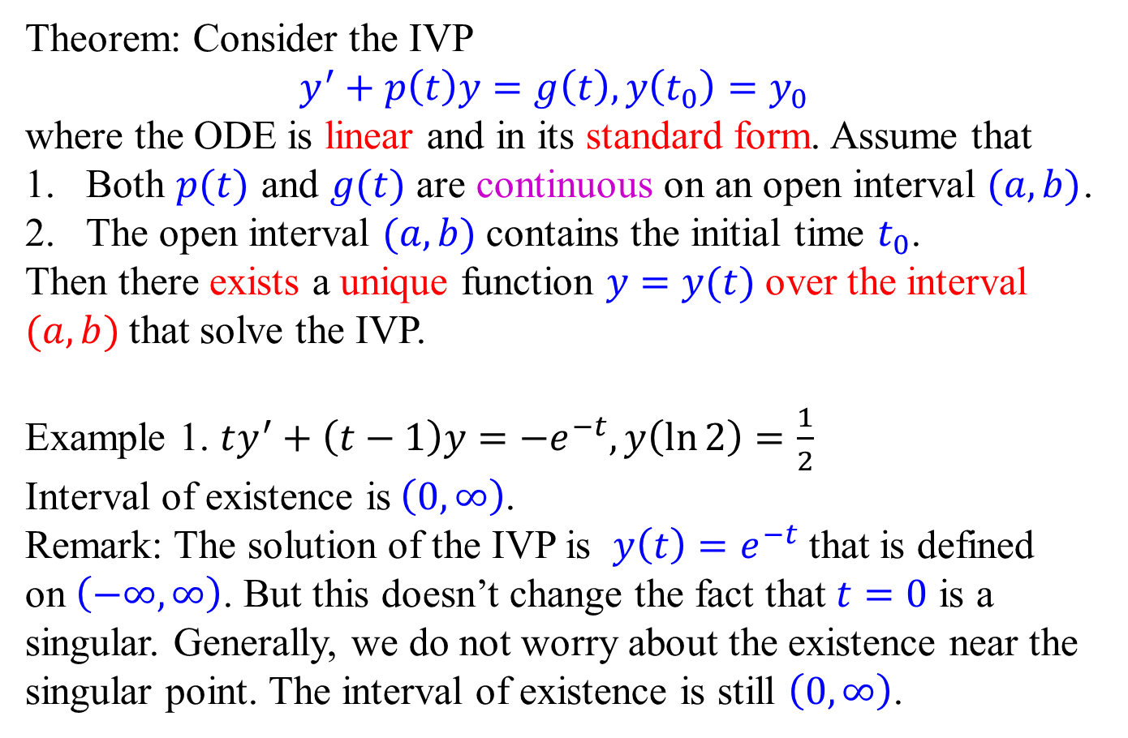
Existence and uniqueness theorem: linear version
Theorem: Consider the IVP
$$y^{′}+p\left(t\right)y=g\left(t\right), y\left(t_{0}\right)=y_{0}$$
where the ODE is linear and in its standard form. Assume that
Both $p(t)$ and $g(t)$ are continuous on an open interval $(a, b)$.
The open interval $(a, b)$ contains the initial time $t_{0}$.
Then there exists a unique function $y=y(t)$ over the interval $(a, b)$ that solve the IVP.
Example 1. $ty^{′}+\left(t−1\right)y=−e^{−t},y\left(\ln{2}\right)=\frac{1}{2}$
Interval of existence is$\left(0, ∞\right)$.
Remark: The solution of the IVP is $y\left(t\right)=e^{−t}$ that is defined on $\left(−∞, ∞\right)$. But this doesn’t change the fact that $t=0$ is a singular. Generally, we do not worry about the existence near the singular point. The interval of existence is still $\left(0,∞\right)$.

Slide 9
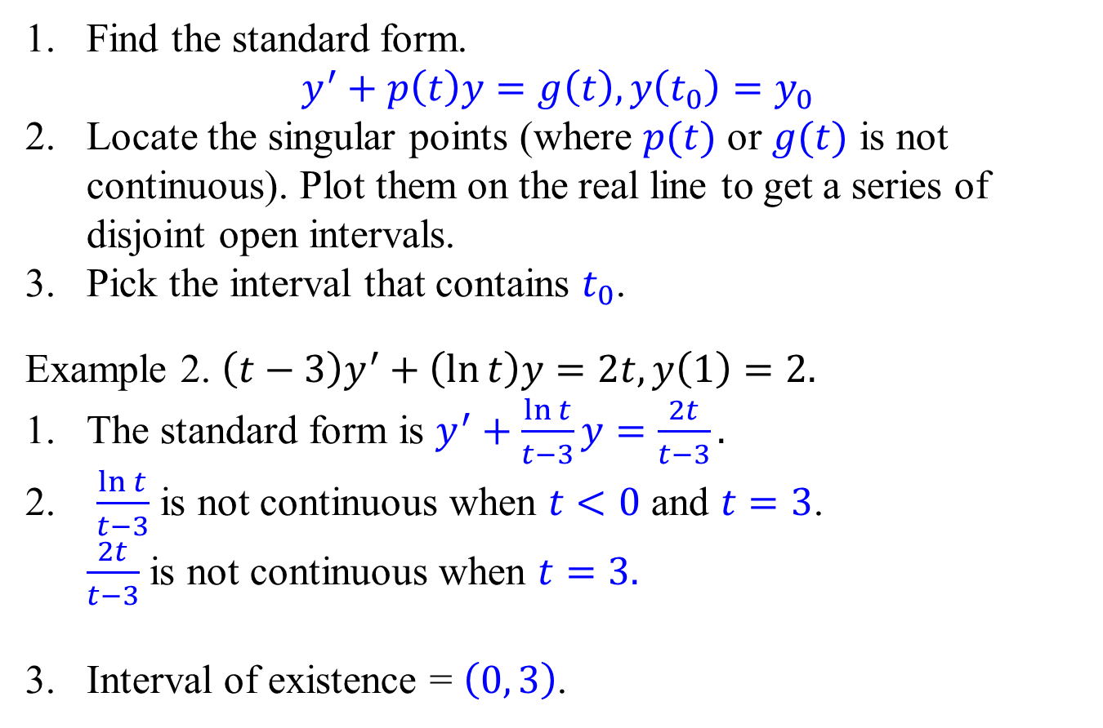

General procedure for interval of existence
Find the standard form. $y^{′}+p\left(t\right)y=g\left(t\right), y\left(t_{0}\right)=y_{0}$
Locate the singular points (where $p(t)$ or $g(t)$ is not continuous). Plot them on the real line to get a series of disjoint open intervals.
Pick the interval that contains $t_{0}$.
Example 2. $\left(t−3\right)y^{′}+\left(\ln{t}\right)y=2t, y\left(1\right)=2.$
The standard form is $y^{′}+\frac{\ln{t}}{t−3}y=\frac{2t}{t−3}.$
$\frac{\ln{t}}{t−3}$ is not continuous when $t<0$ and $t=3$. $\frac{2t}{t−3}$ is not continuous when $t=3.$
Interval of existence = $\left(0, 3\right)$.
0
$$1$$
3

Slide 10
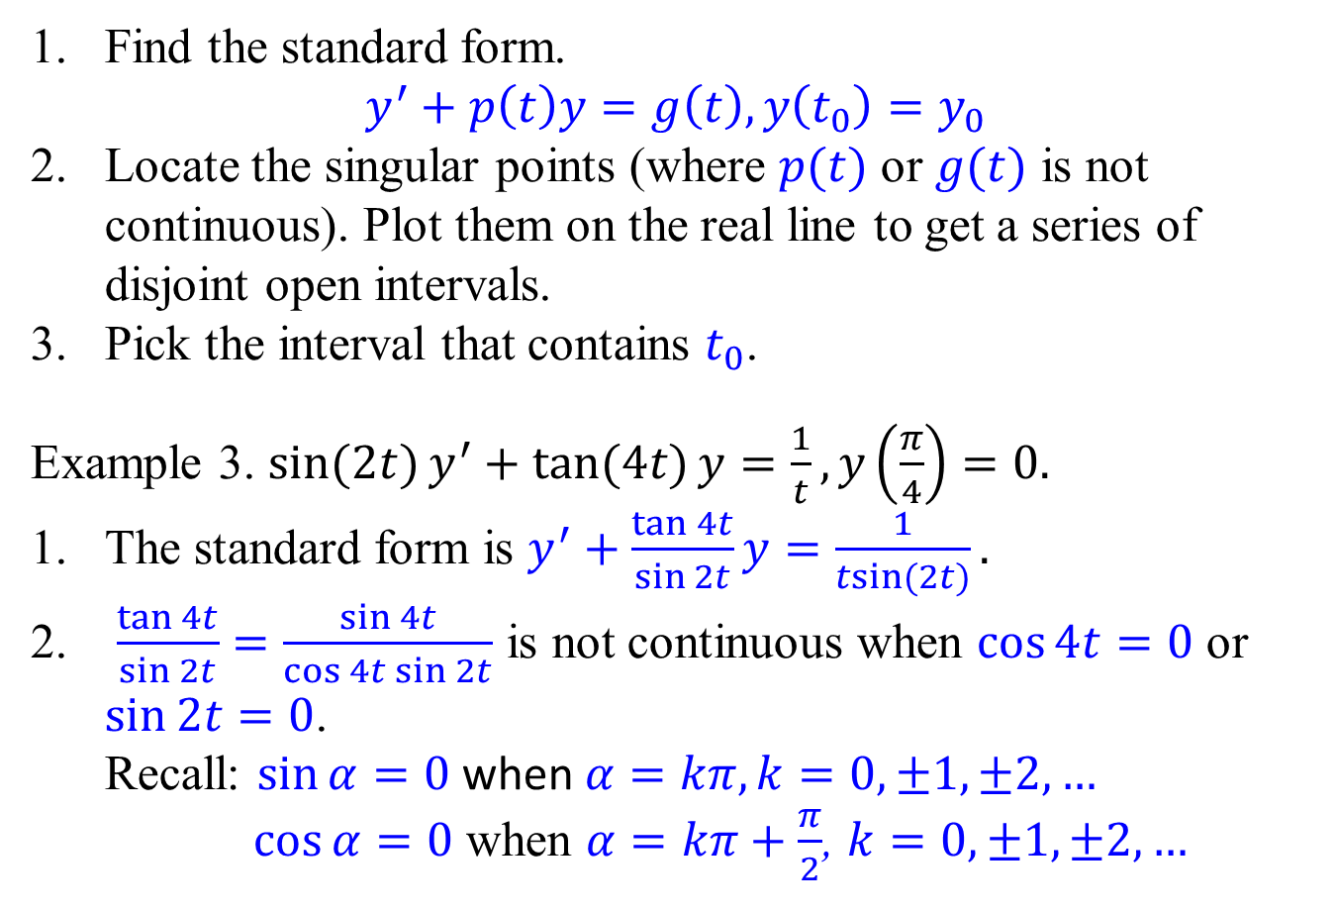
General procedure for interval of existence
Find the standard form. $y^{′}+p\left(t\right)y=g\left(t\right), y\left(t_{0}\right)=y_{0}$
Locate the singular points (where $p(t)$ or $g(t)$ is not continuous). Plot them on the real line to get a series of disjoint open intervals.
Pick the interval that contains $t_{0}$.
Example 3. $\sin{(2t)}y^{′}+\tan{(4t)}y=\frac{1}{t}, y\left(\frac{π}{4}\right)=0.$
The standard form is $y^{′}+\frac{\tan{4t}}{\sin{2t}}y=\frac{1}{\operatorname{tsin}{(2t)}}.$
$\frac{\tan{4t}}{\sin{2t}}=\frac{\sin{4t}}{\cos{4t\sin{2t}}}$ is not continuous when $\cos{4t}=0$ or $\sin{2t}=0$. Recall: $\sin{α}=0$ when $α=kπ, k=0, ±1, ±2, …$ $\cos{α=0}$ when $α=kπ+\frac{π}{2}$, $k=0, ±1, ±2, …$

Slide 11
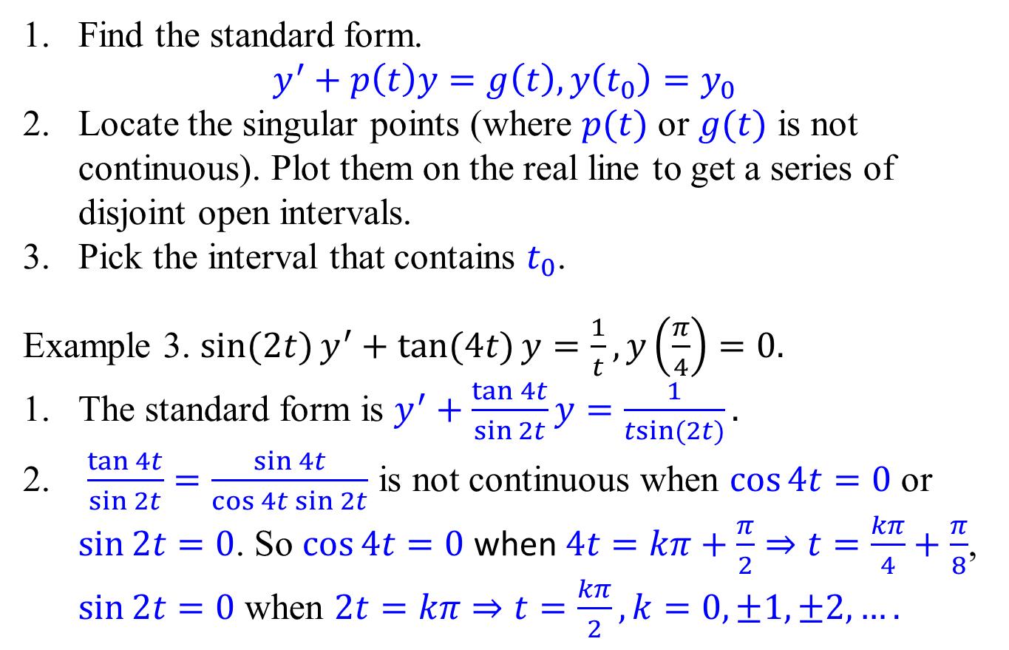
General procedure for interval of existence
Find the standard form. $y^{′}+p\left(t\right)y=g\left(t\right), y\left(t_{0}\right)=y_{0}$
Locate the singular points (where $p(t)$ or $g(t)$ is not continuous). Plot them on the real line to get a series of disjoint open intervals.
Pick the interval that contains $t_{0}$.
Example 3. $\sin{(2t)}y^{′}+\tan{(4t)}y=\frac{1}{t}, y\left(\frac{π}{4}\right)=0.$
The standard form is $y^{′}+\frac{\tan{4t}}{\sin{2t}}y=\frac{1}{\operatorname{tsin}{(2t)}}.$
$\frac{\tan{4t}}{\sin{2t}}=\frac{\sin{4t}}{\cos{4t\sin{2t}}}$ is not continuous when $\cos{4t}=0$ or $\sin{2t}=0$. So $\cos{4t}=0$ when $4t=kπ+\frac{π}{2}⇒t=\frac{kπ}{4}+\frac{π}{8}$, $\sin{2t}=0$ when $2t=kπ⇒t=\frac{kπ}{2},k=0,±1, ±2, ….$

Slide 12



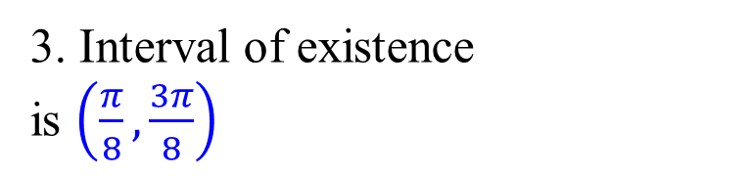


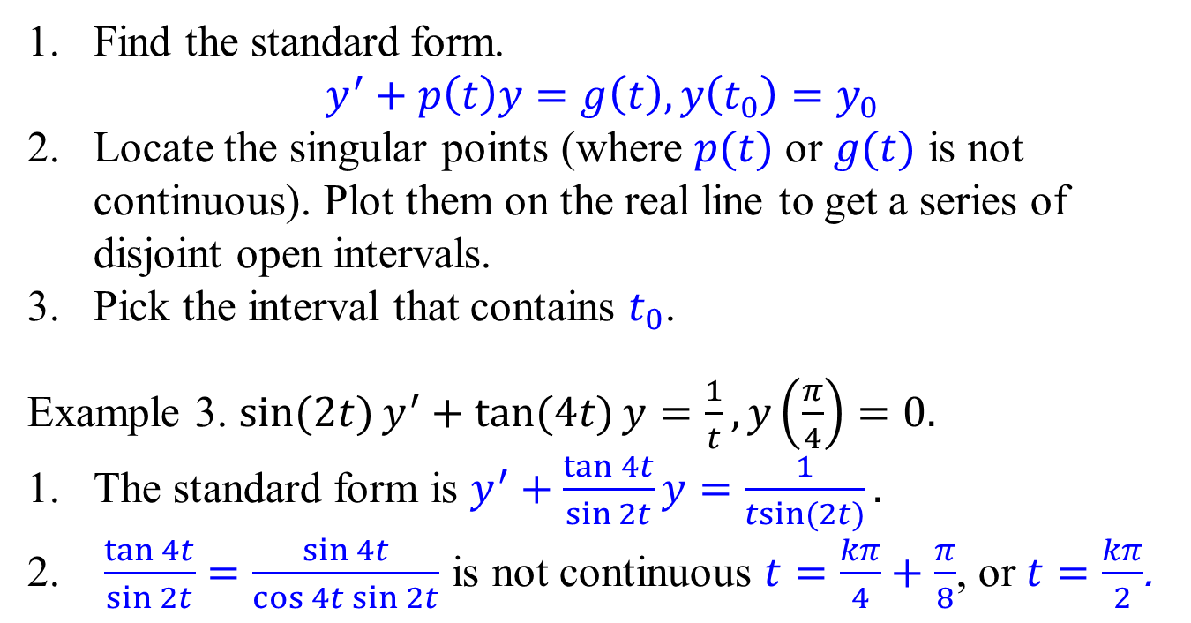

General procedure for interval of existence
Find the standard form. $y^{′}+p\left(t\right)y=g\left(t\right), y\left(t_{0}\right)=y_{0}$
Locate the singular points (where $p(t)$ or $g(t)$ is not continuous). Plot them on the real line to get a series of disjoint open intervals.
Pick the interval that contains $t_{0}$.
Example 3. $\sin{(2t)}y^{′}+\tan{(4t)}y=\frac{1}{t}, y\left(\frac{π}{4}\right)=0.$
The standard form is $y^{′}+\frac{\tan{4t}}{\sin{2t}}y=\frac{1}{\operatorname{tsin}{(2t)}}.$
$\frac{\tan{4t}}{\sin{2t}}=\frac{\sin{4t}}{\cos{4t\sin{2t}}}$ is not continuous $t=\frac{kπ}{4}+\frac{π}{8}$, or $t=\frac{kπ}{2}$.
3. Interval of existence
is $\left(\frac{π}{8},\frac{3π}{8}\right)$
$$−\frac{π}{8}$$
0
$$\frac{π}{8}$$
$$\frac{π}{4}$$
$$\frac{3π}{8}$$
$$\frac{π}{2}$$
$$\frac{5π}{8}$$

Slide 13
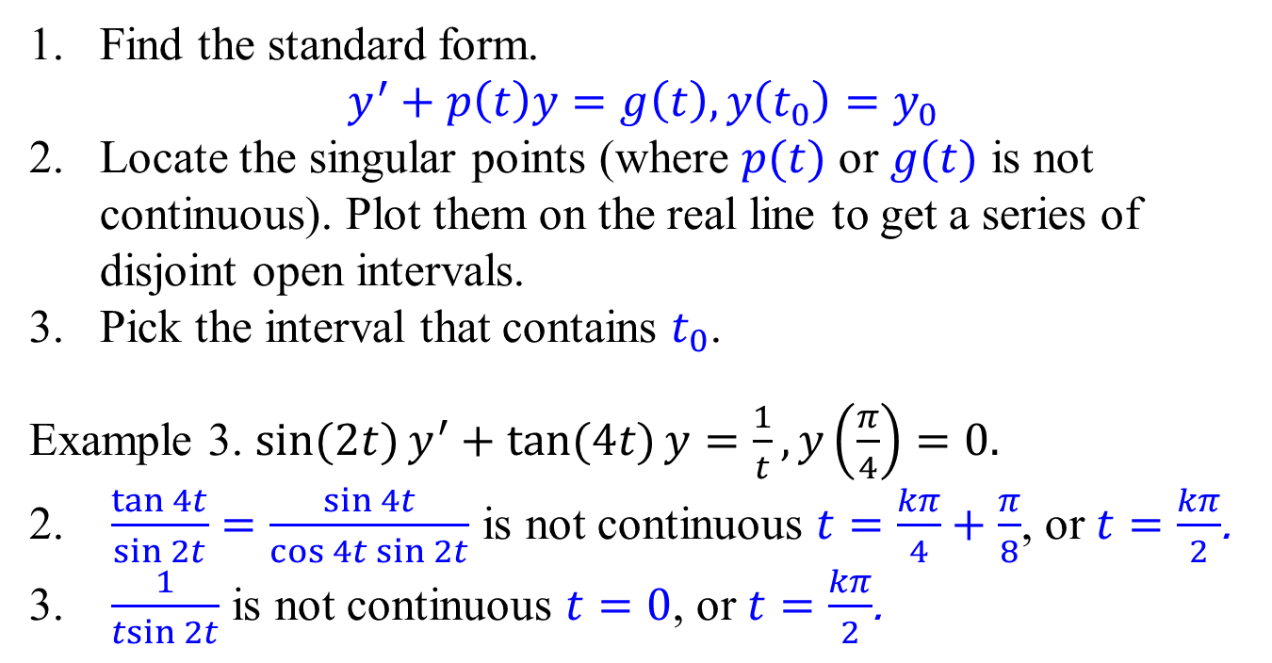
General procedure for interval of existence
Find the standard form. $y^{′}+p\left(t\right)y=g\left(t\right), y\left(t_{0}\right)=y_{0}$
Locate the singular points (where $p(t)$ or $g(t)$ is not continuous). Plot them on the real line to get a series of disjoint open intervals.
Pick the interval that contains $t_{0}$.
Example 3. $\sin{(2t)}y^{′}+\tan{(4t)}y=\frac{1}{t}, y\left(\frac{π}{4}\right)=0.$
$\frac{\tan{4t}}{\sin{2t}}=\frac{\sin{4t}}{\cos{4t\sin{2t}}}$ is not continuous $t=\frac{kπ}{4}+\frac{π}{8}$, or $t=\frac{kπ}{2}$.
$\frac{1}{\operatorname{tsin}{2t}}$ is not continuous $t=0$, or $t=\frac{kπ}{2}$.
3. Interval of existence
is $\left(\frac{π}{8},\frac{3π}{8}\right)$
$$−\frac{π}{8}$$
0
$$\frac{π}{8}$$
$$\frac{π}{4}$$
$$\frac{3π}{8}$$
$$\frac{π}{2}$$
$$\frac{5π}{8}$$

Slide 14

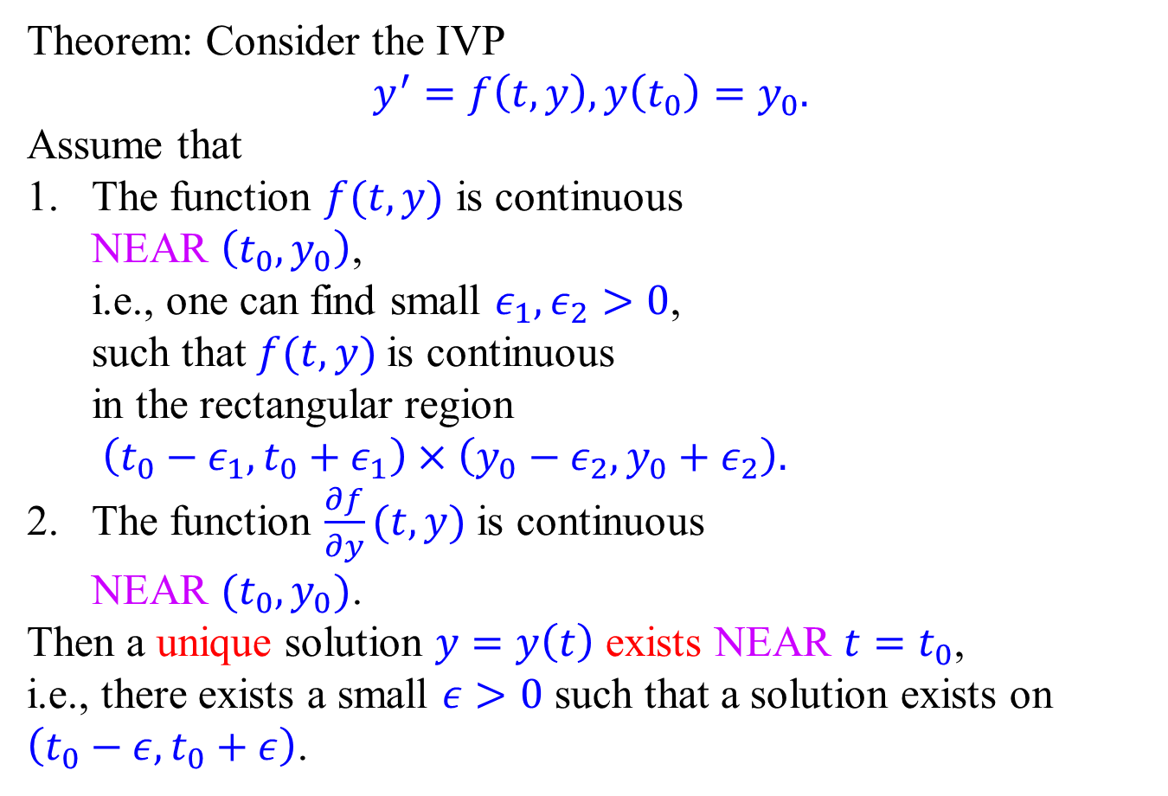







Existence and uniqueness theorem: nonlinear case
Theorem: Consider the IVP
$$y^{′}=f\left(t,y\right), y\left(t_{0}\right)=y_{0}.$$
Assume that
The function $f(t,y)$ is continuous NEAR $\left(t_{0},y_{0}\right)$, i.e., one can find small $ε_{1},ε_{2}>0$, such that $f(t,y)$ is continuous in the rectangular region $\left(t_{0}−ε_{1},t_{0}+ε_{1}\right)×\left(y_{0}−ε_{2},y_{0}+ε_{2}\right).$
The function $\frac{∂f}{∂y}(t,y)$ is continuous NEAR $(t_{0},y_{0})$.
Then a unique solution $y=y\left(t\right)$ exists NEAR $t=t_{0}$, i.e., there exists a small $ε>0$ such that a solution exists on $\left(t_{0}−ε,t_{0}+ε\right)$.
$$y_{0}+ε_{2}$$
$$y_{0}$$
$$y_{0}−ε_{2}$$
$$t_{0}$$
$$t_{0}−ε_{1}$$
$$t_{0}+ε_{1}$$
$$t_{0}−ε$$
$$t_{0}+ε$$

Slide 15
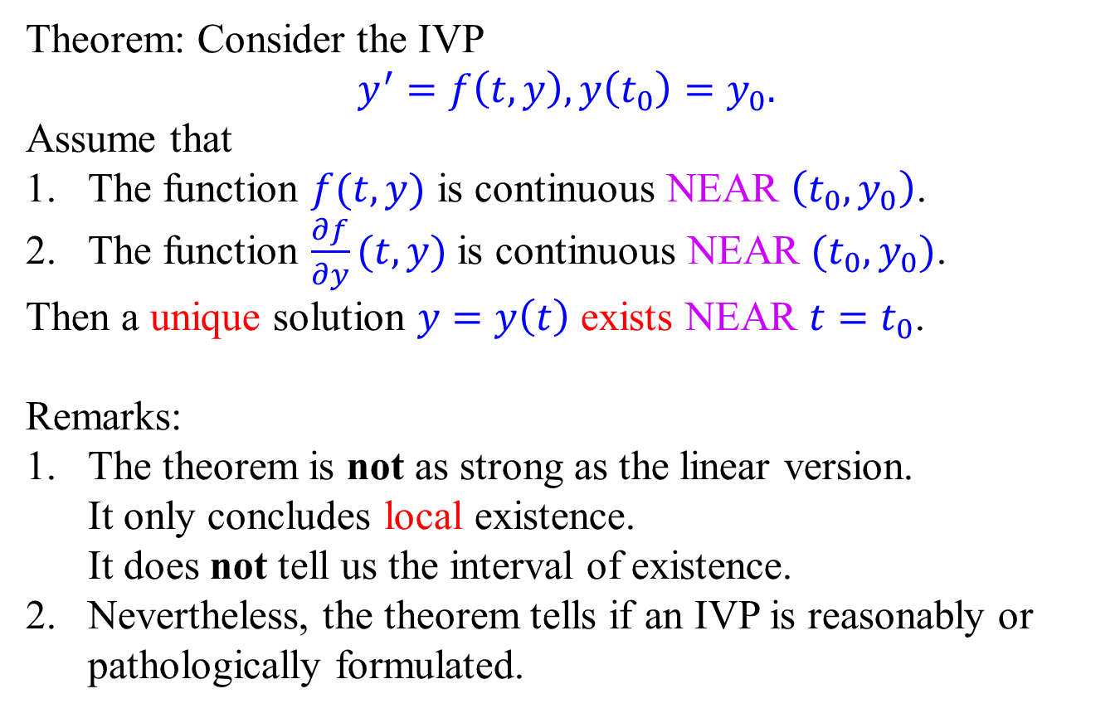
Existence and uniqueness theorem: nonlinear case
Theorem: Consider the IVP
$$y^{′}=f\left(t,y\right), y\left(t_{0}\right)=y_{0}.$$
Assume that
The function $f(t,y)$ is continuous NEAR $\left(t_{0},y_{0}\right)$.
The function $\frac{∂f}{∂y}(t,y)$ is continuous NEAR $(t_{0},y_{0})$.
Then a unique solution $y=y\left(t\right)$ exists NEAR $t=t_{0}$.
Remarks:
The theorem is not as strong as the linear version. It only concludes local existence. It does not tell us the interval of existence.
Nevertheless, the theorem tells if an IVP is reasonably or pathologically formulated.

